Slide 1


Title: Weather App
internship with Edunet Foundation, leveraging IBM SkillsBuild
Subtitle: Real-Time Weather Information at Your Fingertips
Student Details:
Name: ACHHUTA NAND JHA
University : GLA University
AICTE Internship Student Registration ID:STU662a2083d78941714036867

Slide 2
Problem Statement
The need for accurate, real-time weather information accessible from any location.

Slide 3
Agenda
Project Overview
End Users
Solution and Value Proposition
Customization and Unique Features
Modelling and Development
Results and Impact

Slide 4
Project Overview
Introduction to the Weather App and its Key Features:
Real-time weather updates
Location-based information
Customizable alerts
Detailed metrics

Slide 5

End Users
Who Are the End Users?
General Public: Individuals seeking accurate weather forecasts.
Outdoor Enthusiasts: Travelers, hikers, and event planners.
Urban and Rural Residents: People needing weather data for daily planning.
Students and Researchers: Those interested in weather patterns and data.

Slide 6
Solution and Value Proposition
Your Solution and Its Value Proposition:
Provides reliable, real-time weather updates.
Enhances daily planning and safety through accurate forecasts.
Offers a user-friendly interface accessible to all skill levels.
Customizable alerts for severe weather conditions to inform users promptly.

Slide 7
Customization and Unique Features
How Did You Customize the Project and Make It Your Own?
Developed a unique, intuitive UI design.
Integrated local weather data APIs for accuracy.
Included features like historical data access and weather trend analysis.
Added user feedback and support options for continuous improvement.

Slide 8
Modelling and Development
Modelling and Development:
Utilized a robust tech stack including HTML, CSS, JavaScript, and popular weather APIs.
Implemented responsive design for accessibility across devices.
Developed user flow diagrams and wireframes for a streamlined user experience.

Slide 9
Results
Results:
Successfully implemented core features and functionality.
Positive user feedback on accuracy and ease of use.
Increased engagement through customizable alerts and detailed weather metrics.
Demonstrated improved user decision-making in daily planning and activities.

Slide 10
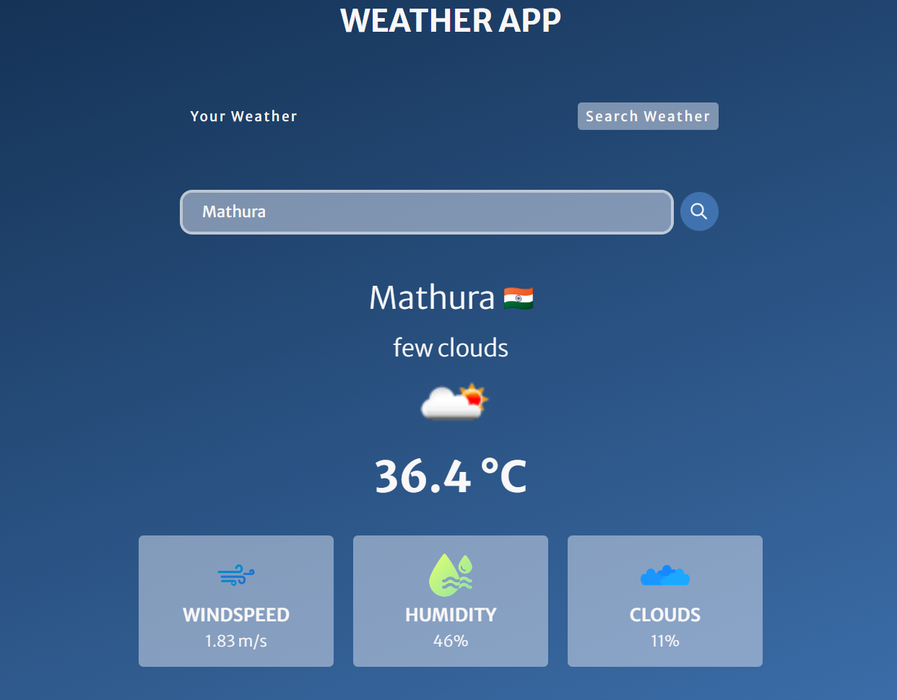
Results

Slide 11
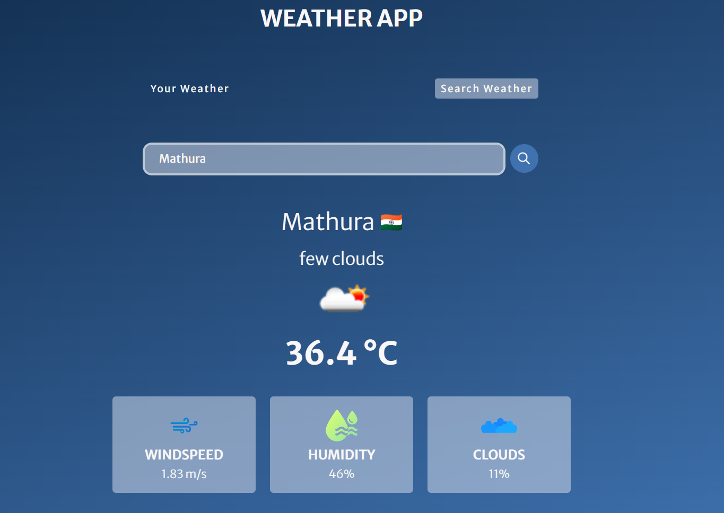
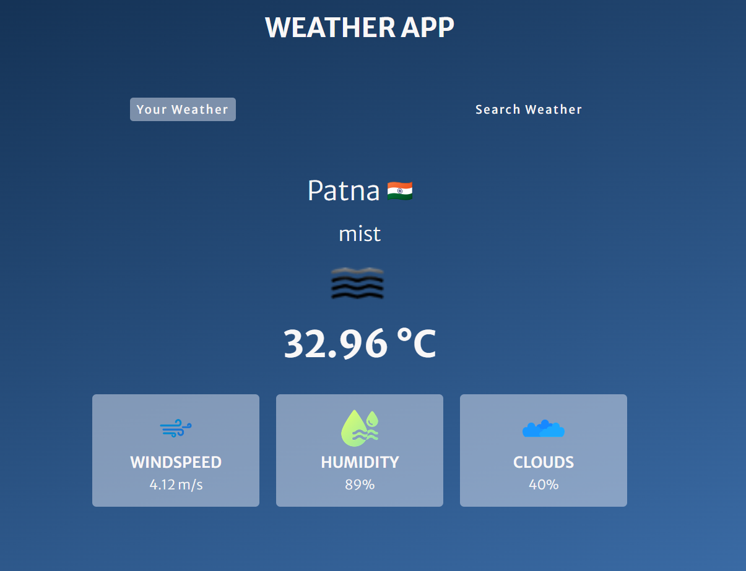
Results

Slide 12
Conclusion
Conclusion:
01
Recap of the project’s objectives, development process, and achieved results.
02
Future plans for additional features and improvements.
03

Slide 13
links
Demo GitHub Link
Demo Video Link
Linkedin Post Link

Slide 14

Thank you for your attention

